Slide 1
Monte-Carlo Simulation
Prepared by: Tomal Majumder
Lecturer, CSE
United International University

Slide 2
Simulation
Simulation is the process of designing a model of a real system.
Conducting experiments on the model for understanding the behaviour of the system.
A duplication of the original system
Understand the implementation of the system

Slide 3
Monte-Carlo Simulation Technique
Understand the concept of Monté Carlo Simulation
Learn how to use Monté Carlo Simulation to make good decisions
Learn how to use Monté Carlo Simulation for estimating complex integrals

Slide 4
What is Monte-Carlo Simulation?
A Monte Carlo simulation is a statistical simulation technique that provides approximate solutions to problems expressed mathematically. It utilizes a sequence of random numbers to perform the simulation.
This technique can be used in different domains:
complex integral computations,
economics,
making decisions in specific complex problems, …

Slide 5
General Algorithm of Monte Carlo Simulation
In general, Monte Carlo Simulation is roughly composed of five steps:
Set up probability distributions: what is the probability distribution that will be considered in the simulation
Build cumulative probability distributions
Establish an interval of random numbers for each variable
Generate random numbers: only accept numbers that satisfies a given condition.
Simulate trials

Slide 6
Examples
Example 1 : using Monte Carlo simulation for the analysis of real systems
Example 2: using Monte Carlo simulation to evaluate an integral.
Notes:
‹#›

Slide 7
Example 1:
Hefry Cake shop: Hefry Cake shop keeps stock of a popular brand of cake. The following data is collected for 200 days:
Simulate the cake shop for 10 days.
Demand For Tiers | Frequency
0 | 10
1 | 20
2 | 40
3 | 60
4 | 40
5 | 30

Slide 8
Probability of Demand
(1) | (2) | (3) | (4)
Demand for Tires | Frequency | Probability of Occurrence | Cumulative Probability
0 | 10 | 10/200 = .05 | .05
1 | 20 | 20/200 = .10 | .15
2 | 40 | 40/200 = .20 | .35
3 | 60 | 60/200 = .30 | .65
4 | 40 | 40/200 = .20 | .85
5 | 30 | 30/ 200 = .15 | 1.00
 | 200 days | 200/200 = 1.00

Slide 9
Assignment of Random Numbers
Daily Demand | Probability | Cumulative Probability | Interval of Random Numbers
0 | .05 | .05 | 00 - 04
1 | .10 | .15 | 05 - 14
2 | .20 | .35 | 15 - 34
3 | .30 | .65 | 35 - 64
4 | .20 | .85 | 65 - 84
5 | .15 | 1.00 | 85 - 99
Table F.3

Slide 10
Table of Random Numbers
52 | 50 | 60 | 52 | 05
37 | 27 | 80 | 69 | 34
82 | 45 | 53 | 33 | 55
69 | 81 | 69 | 32 | 09
98 | 66 | 37 | 30 | 77
96 | 74 | 06 | 48 | 08
33 | 30 | 63 | 88 | 45
50 | 59 | 57 | 14 | 84
88 | 67 | 02 | 02 | 84
90 | 60 | 94 | 83 | 77
Table F.4

Slide 11
Simulation Example 1
Day Number | Random Number | Simulated Daily Demand
1 | 52 | 3
2 | 37 | 3
3 | 82 | 4
4 | 69 | 4
5 | 98 | 5
6 | 96 | 5
7 | 33 | 2
8 | 50 | 3
9 | 88 | 5
10 | 90 | 5
 |  | 39 Total
 |  | 3.9 Average
Select random numbers from Table F.3

Slide 12
Simulation Example 1
Day Number | Random Number | Simulated Daily Demand
1 | 52 | 3
2 | 37 | 3
3 | 82 | 4
4 | 69 | 4
5 | 98 | 5
6 | 96 | 5
7 | 33 | 2
8 | 50 | 3
9 | 88 | 5
10 | 90 | 5
 |  | 39 Total
 |  | 3.9 Average
5
i =1
Expected demand
= ∑ (probability of i units) x (demand of i units)
= (.05)(0) + (.10)(1) + (.20)(2) + (.30)(3) + (.20)(4) + (.15)(5)
= 0 + .1 + .4 + .9 + .8 + .75
= 2.95 tires

Slide 13
Set up probability distributions

Slide 14
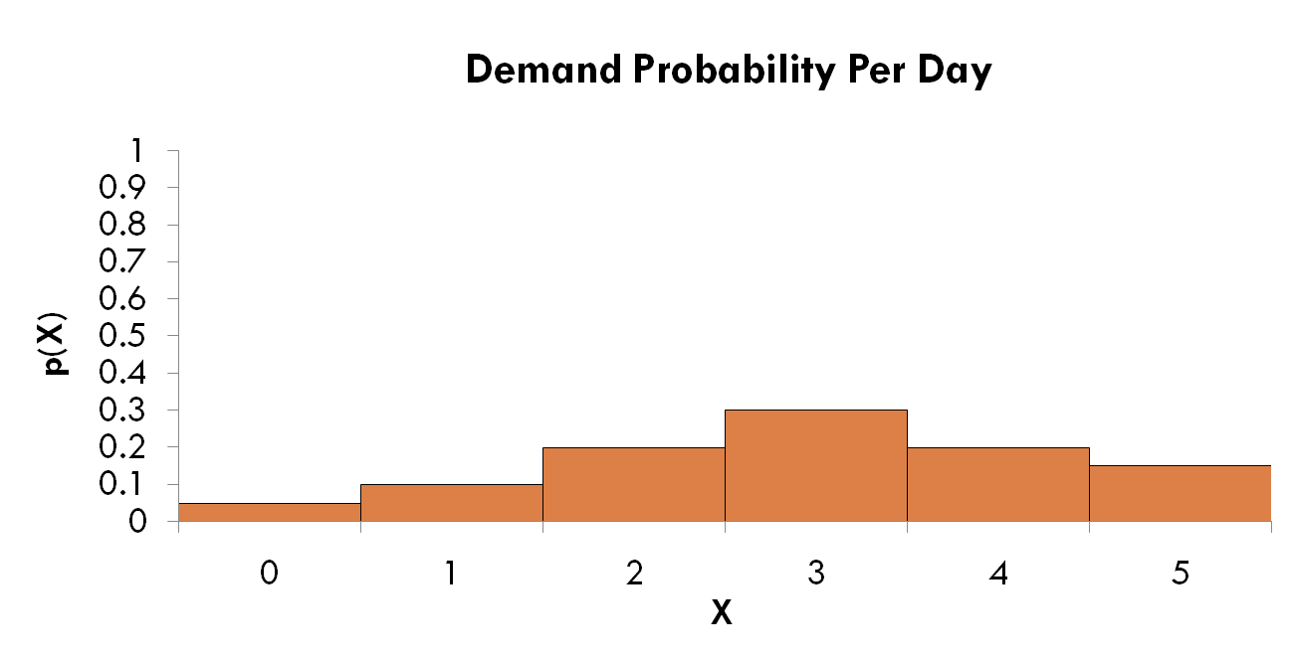
Step 1: Set up the probability distribution for cake sales.
Using historical data HERFY Shop determined that 5% of the time 0 cakes were demanded, 10% of the time 1 cake was demanded, etc…
P(1) = 10%

Slide 15
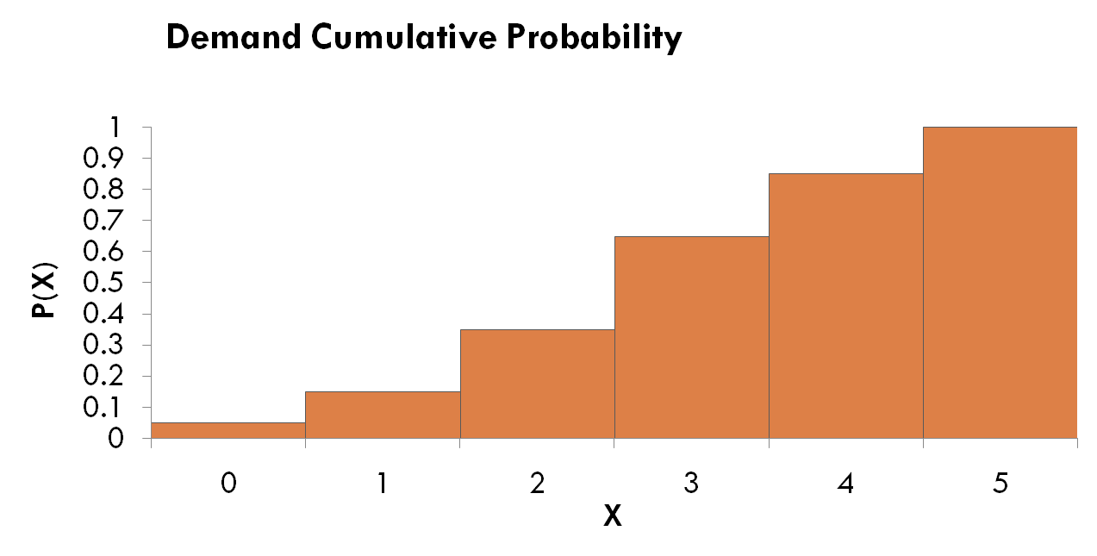
Step 2: Build a Cumulative Probability Distribution
15% of the time the demand was 0 or 1 cake P(0) = 5% + P(1) = 10%

Slide 16
Example 2. Computation of Integrals

Slide 17
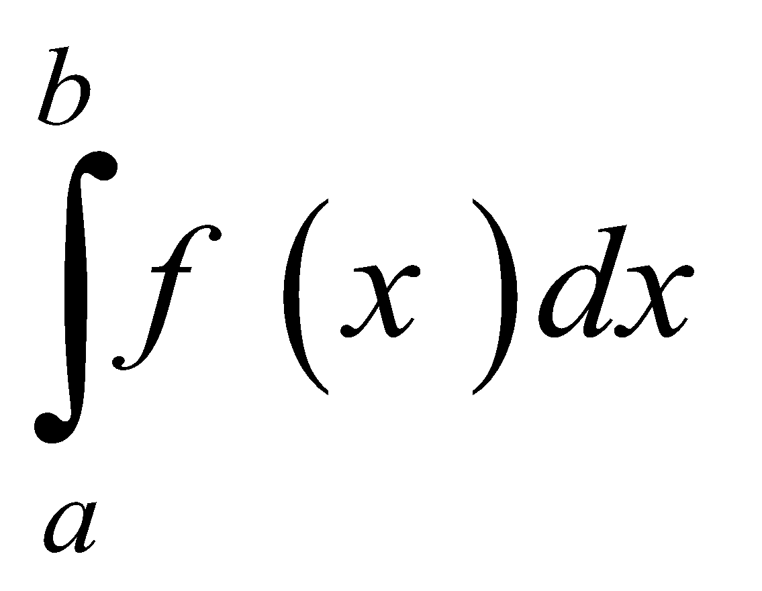
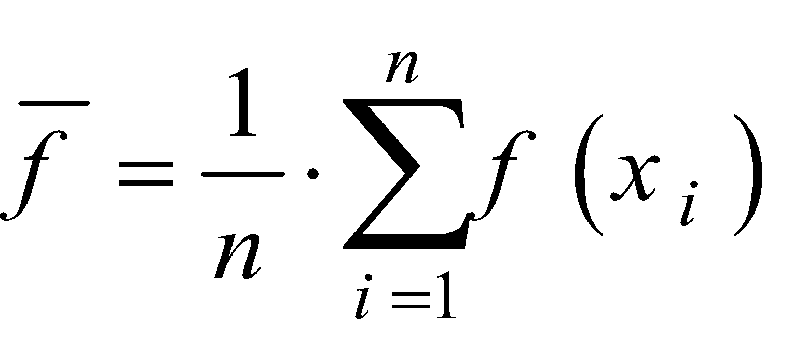
Example 2. Computation of Integrals
The Monte Carlo method can be used to numerically approximate the value of an integral
Pick n randomly distributed points x₁, x₂, …, x_{n} in the interval [a,b]
Determine the average value of the function

Slide 18
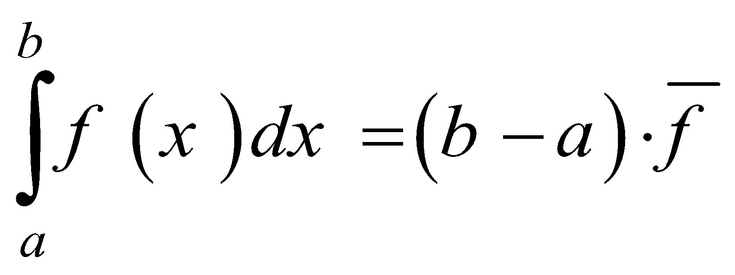
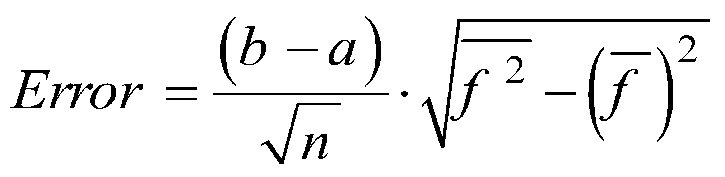
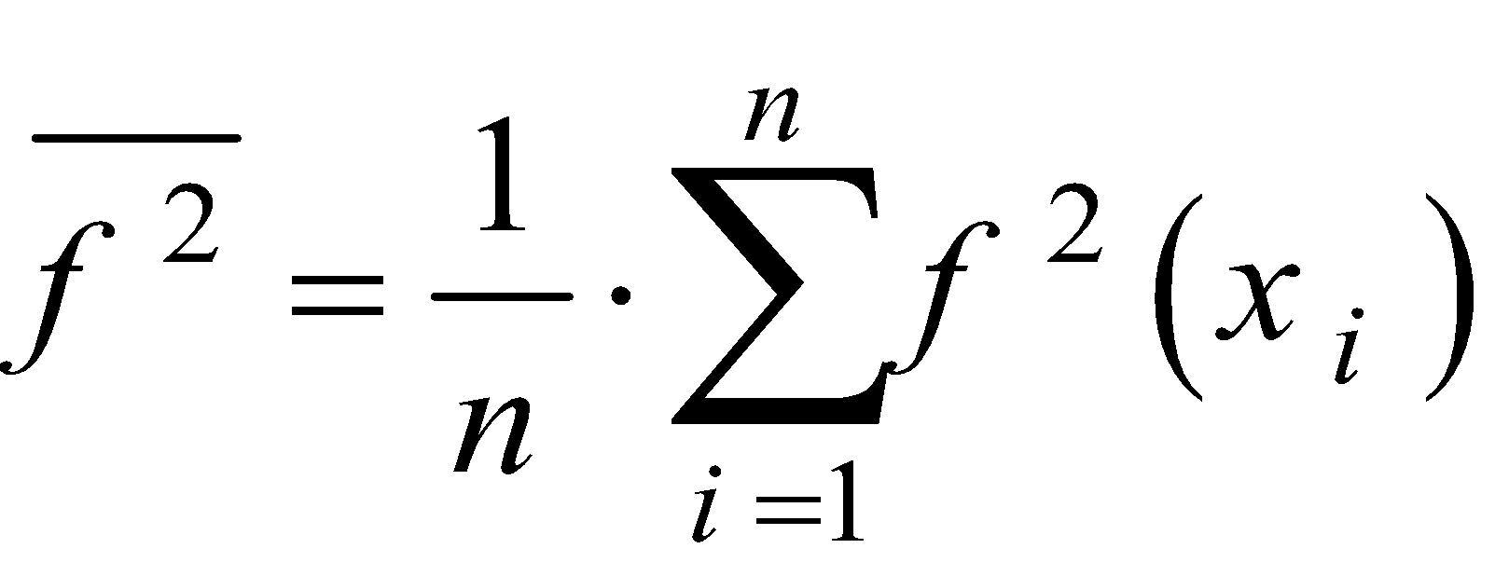
Example 2. Computation of Integrals
Compute the approximation to the integral
An estimate for the error is
Where

Slide 19
Practice Problem
Estimate the integral of sinx from 0 to 1 interval. Use 10 random points. Refer to random table F.4.
Estimate the integral of xe^{x} from 0 to 1 interval. Use 15 random points.Refer to random table F.4.
(Solution has been discussed in the class).

Slide 20
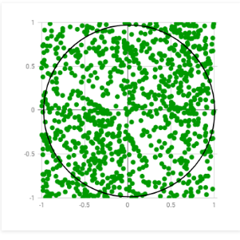
Estimating PI
If you are not a good dart Player, it is easy
to imagine throwing darts randomly at
figure.
It should be apparent that total no. of darts
Hitting within the square and the no. of
darts hitting in the circle is proportional to
area of the circle.

Slide 21
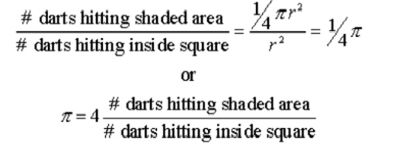
Estimating PI

Slide 22
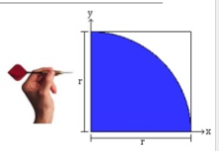
Estimating PI
The idea is to simulate random (x, y) points in a 2-D plane with domain as a square of side 1 unit.
Imagine a circle inside the same domain with same diameter and inscribed into the square. We then calculate the ratio of number points that lied inside the circle and total number of generated points.

Slide 23
Estimating PI
Steps:
x= (random number)
y=(random number)
If x^2+y^2 <= 1, then hits=hits+1.
Calculate PI = 4 (hits / total shots ) .

Slide 24
Thank You.

